Slide 1
GPU programming: CUDA
Acknowledgement: the lecture materials are based on the materials in NVIDIA teaching center CUDA course materials, including materials from Wisconsin (Negrut), North Carolina Charlotte (Wikinson/Li) and NCSA (Kindratenko).

Slide 2
CUDA
CUDA is Nvidia’s scalable parallel programming model and a software environment for parallel computing
Lanugage: CUDA C, minor extension to C/C++
Let the programmer focus on parallel algorithms not parallel programming mechanisms.
A heterogeneous serial-parallel programming model
Desinged to program heterogeneous CPU+GPU systems
CPU and GPU are separate devices with separate memory

Slide 3
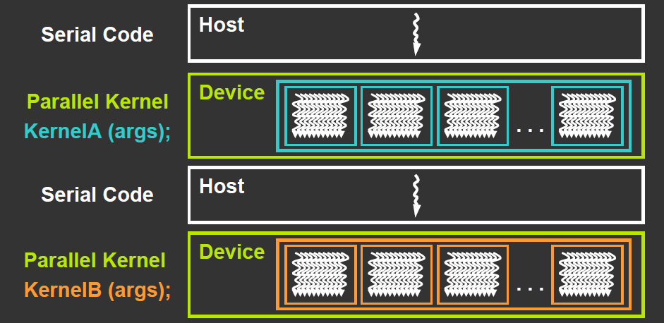
Heterogeneous programming with CUDA
Fork-join model: CUDA program = serial code + parallel kernels (all in CUDA C)
Serial C code executes in a host thread (CPU thread)
Parallel kernel code executes in many device threads (GPU threads)

Slide 4
CUDA kernel
Kernel code is regular C code except that it will use thread ID (CUDA built-in variables) to make different threads operate on different data
Also variables for the total number of threads
When a kernel is reached in the code for the first time, it is launched onto GPU.

Slide 5
CPU and GPU memory
CPU and GPU have different memories:
CPU memory is called host memory
GPU memory is called device memory
Implication:
Explicitly transfer data from CPU to GPU for GPU computation, and
Explicitly transfer results in GPU memory copied back to CPU memory
CPU
CPU main memory
Copy from CPU to GPU
Copy from GPU to CPU
GPU global memory
GPU

Slide 6
Basic CUDA program structure
int main (int argc, char **argv ) {
1. Allocate memory space in device (GPU) for data
2. Allocate memory space in host (CPU) for data
3. Copy data to GPU
4. Call “kernel” routine to execute on GPU
(with CUDA syntax that defines no of threads and their physical structure)
5. Transfer results from GPU to CPU
6. Free memory space in device (GPU)
7. Free memory space in host (CPU)
return;
}

Slide 7
1. Allocating memory in GPU (device)
The cudaMalloc routine:
int size = N *sizeof( int); // space for N integers
int *devA, *devB, *devC; // devA, devB, devC ptrs
cudaMalloc( (void**)&devA, size) );
cudaMalloc( (void**)&devB, size );
cudaMalloc( (void**)&devC, size );
2. Allocating memory in host (CPU)?
The regular malloc routine

Slide 8
3. Transferring data from/to host (CPU) to/from device (GPU)
CUDA routine cudaMemcpy
cudaMemcpy( devA, &A, size, cudaMemcpyHostToDevice);
cudaMemcpy( devB, &B, size, cudaMemcpyHostToDevice);
DevA and devB are pointers to destination in device (return from cudaMalloc and A and B are pointers to host data

Slide 9
3. Defining/invoking kernel routine
Define: CUDA specifier __global__
#define N 256
__global__ void vecAdd(int *A, int *B, int *C) { // Kernel definition
int i = threadIdx.x;
C[i] = A[i] + B[i];
}
int main() {
// allocate device memory &
// copy data to device
// device mem. ptrs devA,devB,devC
vecAdd<<<1, N>>>(devA,devB,devC);
…
}
Each thread performs one pair-wise addition:
Thread 0: devC[0] = devA[0] + devB[0];
Thread 1: devC[1] = devA[1] + devB[1];
Thread 2: devC[2] = devA[2] + devB[2];
This is the fork-join statement in Cuda
Notice the devA/B/C are device memory
pointer

Slide 10
CUDA kernel invocation
<<<…>>> syntax (addition to C) for kernel calls:
myKernel<<< n, m >>>(arg1, … );
<<< … >>> contains thread organization for this particular kernel call in two parameters, n and m:
vecAdd<<<1, N>>>(devA,devB,devC): 1 dimension block with N threads
Threads execute very efficiently on GPU: we can have fine-grain threads (a few statements)
More thread organization later
arg1, … , -- arguments to routine myKernel typically pointers to device memory obtained previously from cudaMallac.

Slide 11
5. Transferring data from device (GPU) to host (CPU)
CUDA routine cudaMemcpy
cudaMemcpy( &C, dev_C, size, cudaMemcpyDeviceToHost);
dev_C is a pointer in device memory and C is a pointer in host memory.

Slide 12
6. Free memory space
In “device” (GPU) -- Use CUDA cudaFree routine:
cudaFree( dev_a);
cudaFree( dev_b);
cudaFree( dev_c);
In (CPU) host (if CPU memory allocated with malloc) -- Use regular C free routine:
free( a );
free( b );
free( c );

Slide 13
Complete CUDA examples
See vecadd.cu
Compare the speed of vecadd.c and vecadd.cu
See also vec_complex.c and vec_complex.cu
Compiling CUDA programs
Use the gpu.cs.fsu.edu (gpu1, gpu2, gpu3)
Naming convention .cu programs are CUDA programs
NVIDIA CUDA compiler driver: nvcc
To compile vecadd.cu: nvcc –O3 vecadd.cu

Slide 14
Compilation process
nvcc “wrapper” divides code into host and device parts.
Host part compiled by regular C compiler
Device part compiled by NVIDIA “ptxas” assembler
Two compiled parts combined into one executable
nvcc
ptxas
gcc
executable
Executable file a “fat” binary” with both host and device code

